Slide 1



| University of San Jose - Recoletos | School of Computer Studies
| Quantitative Methods | Engr. Violdan E. Bayocot
SUB-MODULE 01.01 – ONE WAY TABLES
MODULE 01
VISUALIZING DATA
ENGR. VIOLDAN E. BAYOCOT
[Krista K.] BECOME A PROBABILITY & STATISTICS MASTER
QUANTITATIVE METHODS

Slide 2
INDIVIDUALS AND VARIABLES
A set of individuals with one or more properties is called variables. The individuals are the items in the data set and can be cases, things, people, etc.
Person | Height
Wendy | 5’6”
Michael | 5’9”
Rachael | 5’3”
Allen | 5’11”
In this table the individuals are the people and their heights are a variable because height is a property of each individual
Together, individuals and variables are called data.
When we organize data into a table, we call it a data table.
ENGR. VIOLDAN E. BAYOCOT
[Krista K.] BECOME A PROBABILITY & STATISTICS MASTER
QUANTITATIVE METHODS

Slide 3
INDIVIDUALS AND VARIABLES
Here’s an example of a data table about ice cream
Flavor | Scoops Sold | Contains chocolate? | Smooth or chunky?
Vanilla | 300 | No | Smooth
Chocolate | 450 | Yes | Smooth
Cookies & Cream | 275 | Yes | Chunky
Mint Chocolate Chip | 315 | Yes | Chunky
Fudge Brownie | 375 | Yes | Chunky
Rocky Road | 250 | Yes | Chunky
Individuals
Variables
ENGR. VIOLDAN E. BAYOCOT
[Krista K.] BECOME A PROBABILITY & STATISTICS MASTER
QUANTITATIVE METHODS

Slide 4
INDIVIDUALS AND VARIABLES
Variables
can be categorical or quantitative
Non-numerical variables
Numerical variables
Also called qualitative variables
Their values aren’t represented with numbers. This is because the values there are words, not numbers.
Their values are numbers.
The height of the people and the number of scoops of ice cream sold are quantitative variables
Discrete variables
Continuous variables
are those that we can obtain by counting. Therefore, they can take on only certain numerical values
The number of scoops of ice cream sold is a discrete quantitative variable, because we can’t really sell 8.3 or 5.23 scoops of ice cream.
may include data as decimals, fractions, or irrational numbers.
For example, the height of the people is a continuous variable.
ENGR. VIOLDAN E. BAYOCOT
[Krista K.] BECOME A PROBABILITY & STATISTICS MASTER
QUANTITATIVE METHODS

Slide 5
LEVELS OF MEASUREMENT
Not every statistical test can be used with every type of data set.
There are four levels of data measurement:
Nominal
Ordinal
Interval
Ratio
Only categorical data can be measured with a nominal scale
Categorical data can also be ordinal. This type of data can be ordered.
Can be ordered like ordinal data but interval data also gives us a known interval between measurements
Just like interval scale data, except that it has a starting point, or absolute zero.
Things like favorite food, colors, names and yes or no responses have a nominal scale of measurement
The top three national parks in Philippines is an example of ordinal data. Or, for example, when we ask a group of people about how they liked their trip, we may get responses like awesome, good, satisfactory, terrible, or in numerical form (4,3,2,1), which follow an order from best to worst.
Whereas interval data like temperature can have negative and positive values, things like time duration, height, and weight are examples of ratio scale data because those measures can never be negative.
For example, temperature is measured using an interval scale, because we can understand the exact interval of difference between 50 and 60 degrees.
ENGR. VIOLDAN E. BAYOCOT
[Krista K.] BECOME A PROBABILITY & STATISTICS MASTER
QUANTITATIVE METHODS

Slide 6
CONSTRUCTION ONE-WAY TABLES
When we construct a table, we want to think about whether we have more individuals or more variables.
If we have lots of variables but only a few individuals, it can be helpful to list the individuals across the top and the variables down the left side.
For example, if we’re comparing lots of information about two houses for sale in the same neighborhood, we might make a table like this:
ENGR. VIOLDAN E. BAYOCOT
[Krista K.] BECOME A PROBABILITY & STATISTICS MASTER
QUANTITATIVE METHODS

Slide 7
CONSTRUCTION ONE-WAY TABLES
 | 317 Molave St | 819 Camagong St
Price | ₱16,800,000 | ₱19,500,000
Square meter | 339 | 354
Price per square meter | ₱49,560 | ₱55,085
Bedroom | 4 | 5
Bathrooms | 3 | 3
Storeys | 3 | 2
Basement | Finished | Unfinished
Garage Spaces | 3 | 2
Lot area (sqm) | 300 | 288
Grass Backyard | Yes | Yes
Year built | 2005 | 2018
Property Tax | ₱18,500 | ₱22,000
Payment | ₱78,000 | ₱72,000
For example, if we’re comparing lots of information about two houses for sale in the same neighborhood, we might make a table like this:
All the variables are listed down the left side of the table.
Since there are so many more variables than individuals, listing the variables vertically makes the table fit better on paper than if we had tried to list all the variables horizontally.
ENGR. VIOLDAN E. BAYOCOT
[Krista K.] BECOME A PROBABILITY & STATISTICS MASTER
QUANTITATIVE METHODS

Slide 8
| University of San Jose - Recoletos | School of Computer Studies
| Quantitative Methods | Engr. Violdan E. Bayocot
SUB-MODULE 01.02 – BAR GRAPHS AND PIE CHARTS
MODULE 01
VISUALIZING DATA
ENGR. VIOLDAN E. BAYOCOT
[Krista K.] BECOME A PROBABILITY & STATISTICS MASTER
QUANTITATIVE METHODS

Slide 9
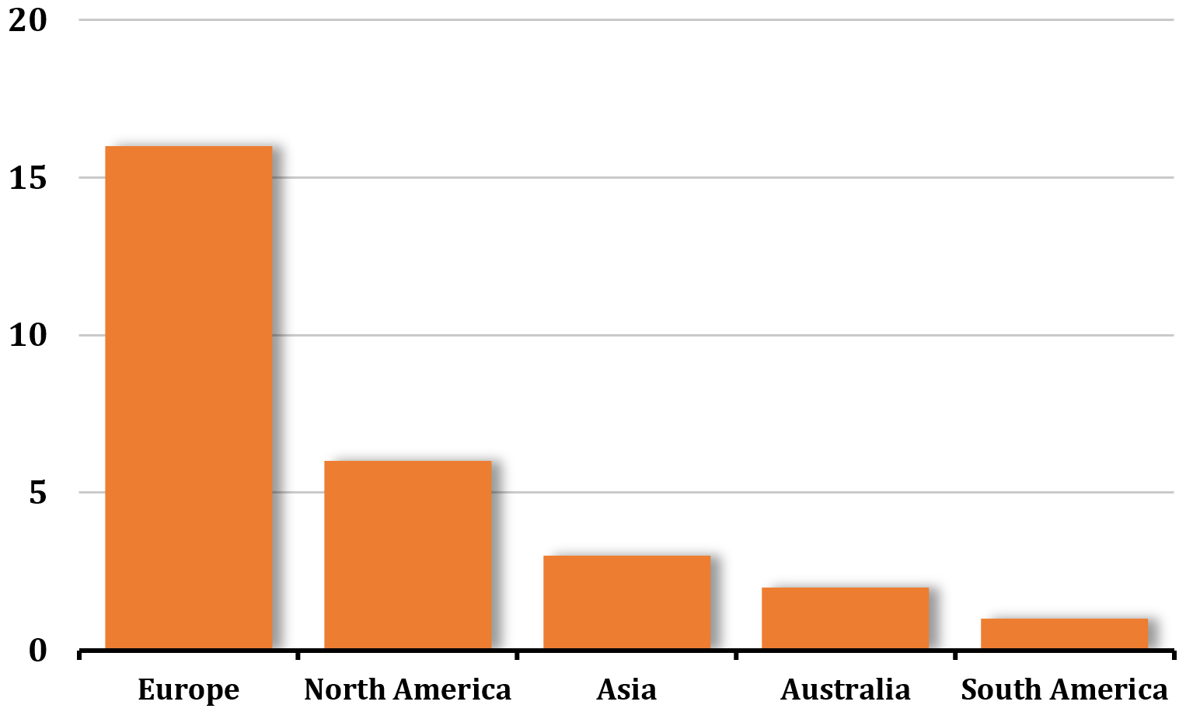
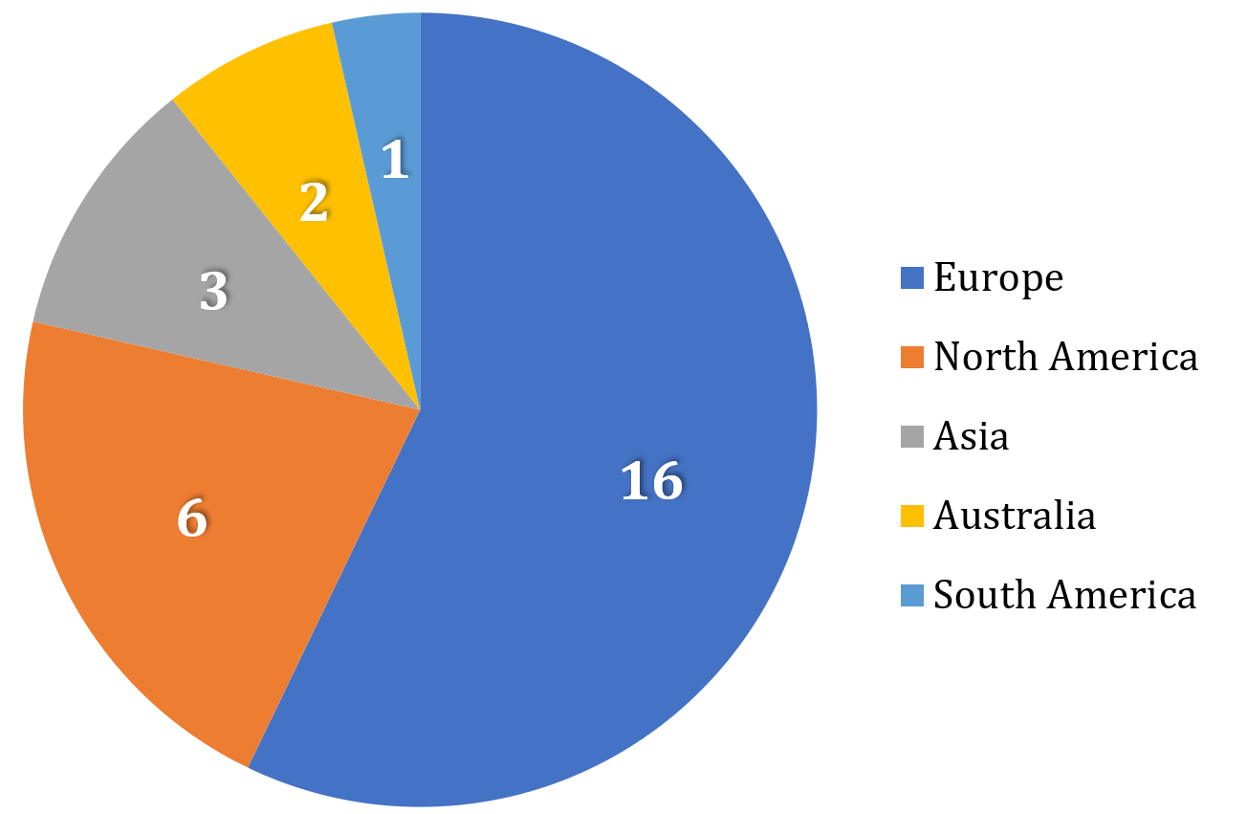
BAR GRAPHS AND PIE CHARTS
Bar graphs and pie charts are two of the simplest ways to summarize and represent data. In general, a bar graph, also called a bar chart.
ENGR. VIOLDAN E. BAYOCOT
[Krista K.] BECOME A PROBABILITY & STATISTICS MASTER
QUANTITATIVE METHODS

Slide 10

BAR GRAPHS AND PIE CHARTS
For this part of the lecture, please turn on your computer and follow along with me.
This will be your Laboratory Exercise 01 and it will be checked after the session.
1. Open Microsoft Excel
2. Download the dataset in the LMS
oly_summergames_dataset
oly_wintergames_dataset
avgtemp_dataset
savings_dataset
ENGR. VIOLDAN E. BAYOCOT
[Krista K.] BECOME A PROBABILITY & STATISTICS MASTER
QUANTITATIVE METHODS

Slide 11
BUILDING DATA TABLES
Let’s say we’re given historical information about the host cities for the summer Olympic games, and we want to summarize this information into a simple data table.
Here is a list of host cities for the summer games, not including host cities for canceled games, from 1896 through 2016.
Games | Year | City, Country | Continent
I | 1896 | Athens, Greece | Europe
II | 1900 | Paris, France | Europe
III | 1904 | St. Louis, United States | North America
IV | 1908 | London, United Kingdom | Europe
V | 1912 | Stockholm, Sweden | Europe
VII | 1920 | Antwerp, Belgium | Europe
VIII | 1924 | Paris, France | Europe
IX | 1928 | Amsterdam, Netherlands | Europe
X | 1932 | Los Angeles, United States | North America
XI | 1936 | Berlin, Germany | Europe
XIV | 1948 | London, United Kingdom | Europe
XV | 1952 | Helsinki, Finland | Europe
XVI | 1956 | Melbourne, Australia | Australia
XVII | 1960 | Rome, Italy | Europe
Games | Year | City, Country | Continent
XVIII | 1964 | Tokyo, Japan | Asia
XIX | 1968 | Mexico City, Mexico | North America
XX | 1972 | Munich, West Germany | Europe
XXI | 1976 | Montreal, Canada | North America
XXII | 1980 | Moscow, Soviet Union | Europe
XXIII | 1984 | Los Angeles, United States | North America
XXIV | 1988 | Seoul, South Korea | Asia
XXV | 1992 | Barcelona, Spain | Europe
XXVI | 1996 | Atlanta, United States | North America
XXVII | 2000 | Sydney, Australia | Australia
XXVIII | 2004 | Athens, Greece | Europe
XXIX | 2008 | Beijing, China | Asia
XXX | 2012 | London, United Kingdom | Europe
XXXI | 2016 | Rio de Janeiro, Brazil | South America
ENGR. VIOLDAN E. BAYOCOT
[Krista K.] BECOME A PROBABILITY & STATISTICS MASTER
QUANTITATIVE METHODS

Slide 12
BUILDING DATA TABLES
Games | Year | City, Country | Continent
I | 1896 | Athens, Greece | Europe
II | 1900 | Paris, France | Europe
III | 1904 | St. Louis, United States | North America
IV | 1908 | London, United Kingdom | Europe
V | 1912 | Stockholm, Sweden | Europe
VII | 1920 | Antwerp, Belgium | Europe
VIII | 1924 | Paris, France | Europe
IX | 1928 | Amsterdam, Netherlands | Europe
X | 1932 | Los Angeles, United States | North America
XI | 1936 | Berlin, Germany | Europe
XIV | 1948 | London, United Kingdom | Europe
XV | 1952 | Helsinki, Finland | Europe
XVI | 1956 | Melbourne, Australia | Australia
XVII | 1960 | Rome, Italy | Europe
Games | Year | City, Country | Continent
XVIII | 1964 | Tokyo, Japan | Asia
XIX | 1968 | Mexico City, Mexico | North America
XX | 1972 | Munich, West Germany | Europe
XXI | 1976 | Montreal, Canada | North America
XXII | 1980 | Moscow, Soviet Union | Europe
XXIII | 1984 | Los Angeles, United States | North America
XXIV | 1988 | Seoul, South Korea | Asia
XXV | 1992 | Barcelona, Spain | Europe
XXVI | 1996 | Atlanta, United States | North America
XXVII | 2000 | Sydney, Australia | Australia
XXVIII | 2004 | Athens, Greece | Europe
XXIX | 2008 | Beijing, China | Asia
XXX | 2012 | London, United Kingdom | Europe
XXXI | 2016 | Rio de Janeiro, Brazil | South America
If we wanted to make a data table showing the number of times each continent has hosted to summer games, we could count this number for each continent from the data table, and create a summary table for count by continent
ENGR. VIOLDAN E. BAYOCOT
[Krista K.] BECOME A PROBABILITY & STATISTICS MASTER
QUANTITATIVE METHODS

Slide 13
BUILDING DATA TABLES
Games | Year | City, Country | Continent
I | 1896 | Athens, Greece | Europe
II | 1900 | Paris, France | Europe
III | 1904 | St. Louis, United States | North America
IV | 1908 | London, United Kingdom | Europe
V | 1912 | Stockholm, Sweden | Europe
VII | 1920 | Antwerp, Belgium | Europe
VIII | 1924 | Paris, France | Europe
IX | 1928 | Amsterdam, Netherlands | Europe
X | 1932 | Los Angeles, United States | North America
XI | 1936 | Berlin, Germany | Europe
XIV | 1948 | London, United Kingdom | Europe
XV | 1952 | Helsinki, Finland | Europe
XVI | 1956 | Melbourne, Australia | Australia
XVII | 1960 | Rome, Italy | Europe
Games | Year | City, Country | Continent
XVIII | 1964 | Tokyo, Japan | Asia
XIX | 1968 | Mexico City, Mexico | North America
XX | 1972 | Munich, West Germany | Europe
XXI | 1976 | Montreal, Canada | North America
XXII | 1980 | Moscow, Soviet Union | Europe
XXIII | 1984 | Los Angeles, United States | North America
XXIV | 1988 | Seoul, South Korea | Asia
XXV | 1992 | Barcelona, Spain | Europe
XXVI | 1996 | Atlanta, United States | North America
XXVII | 2000 | Sydney, Australia | Australia
XXVIII | 2004 | Athens, Greece | Europe
XXIX | 2008 | Beijing, China | Asia
XXX | 2012 | London, United Kingdom | Europe
XXXI | 2016 | Rio de Janeiro, Brazil | South America
Continent | Count
Europe | 16
North America | 6
Asia | 3
Australia | 2
South America | 1
If we wanted to make a data table showing the number of times each continent has hosted to summer games, we could count this number for each continent from the data table, and create a summary table for count by continent
The summary table is often called a frequency table, which shows the frequency or count of each individual.
ENGR. VIOLDAN E. BAYOCOT
[Krista K.] BECOME A PROBABILITY & STATISTICS MASTER
QUANTITATIVE METHODS

Slide 14
BUILDING
BAR GRAPHS
Continent | Count
Europe | 16
North America | 6
Asia | 3
Australia | 2
South America | 1
If we wanted to express the count of summer games by continent in a bar graph, it might look like this:
The bar graph is a nice way to represent this data, because we can quickly get a visual picture of which continents have hosted the summer games most often.
Now we can quickly see that Europe has hosted more summer games by far than any other continent, North America has hosted the second-most number, and South America has hosted the summer games the fewest number of times. With this particular dataset, since we know there are 7 continents, we could infer from the graph that Africa and Antarctica have never hosted the summer games.
ENGR. VIOLDAN E. BAYOCOT
[Krista K.] BECOME A PROBABILITY & STATISTICS MASTER
QUANTITATIVE METHODS

Slide 15
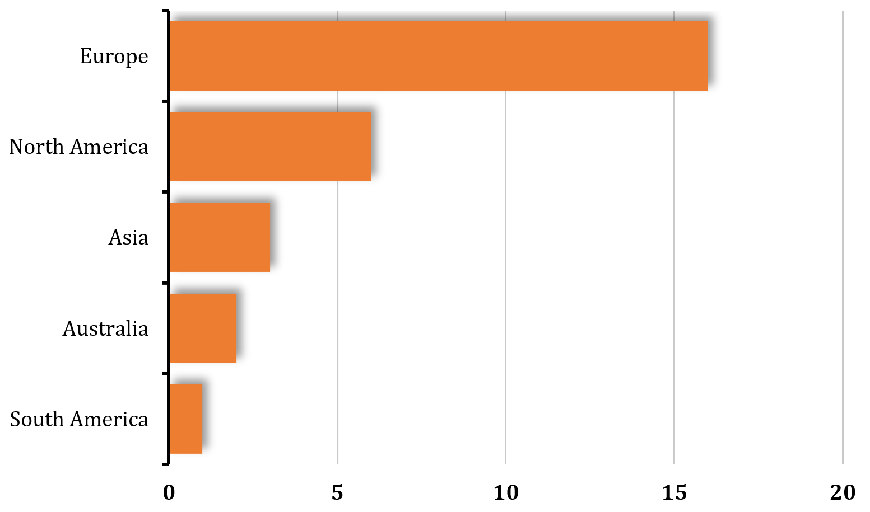
BUILDING
BAR GRAPHS
Continent | Count
Europe | 16
North America | 6
Asia | 3
Australia | 2
South America | 1
Bar graphs can also be built horizontally
When we build a vertical bar graph, it’s common to sort the data largest to smallest, so that the tallest bars appear on the left, in descending order down to the smallest bars on the right.
When we build a horizontal bar graph, it’s common to put the largest bars at the top and the smallest bars at the bottom (this is reversed in Microsoft Excel – sort to smallest to largest)
ENGR. VIOLDAN E. BAYOCOT
[Krista K.] BECOME A PROBABILITY & STATISTICS MASTER
QUANTITATIVE METHODS

Slide 16
READING
BAR GRAPHS
Continent | Count
Europe | 16
North America | 6
Asia | 3
Australia | 2
South America | 1
If we only have the bar graph, and no data table to work with, we may only be able to get approximate values from the bar graph.
We see that the vertical axis isn’t marked off at every increment, only at every increment of 5. So based on how far up the bar extends for Europe, we only know with absolute certainty that it has hosted between 15 and 20 times. We could probably guess that they’ve hosted about 16 or 17 summer games, but we might not feel absolutely sure.
At quick glance we would know that Australia has probably hosted only 2 or 3 times
It’s worth making the point that bar graphs aren’t always great at expressing exact values, but they’re excellent at giving us a quick visual picture of data.
ENGR. VIOLDAN E. BAYOCOT
[Krista K.] BECOME A PROBABILITY & STATISTICS MASTER
QUANTITATIVE METHODS

Slide 17
BUILDING PIE CHARTS
Continent | Count
Europe | 16
North America | 6
Asia | 3
Australia | 2
South America | 1
From same data, we can also make a pie chart
It’s helpful in a pie chart, though not necessary, to make each individual a different color so that it’s easy to see the distinction between sections
Like the bar graphs, it’s customary to put the largest slices next to each other, in order all the way down to the smallest sections
ENGR. VIOLDAN E. BAYOCOT
[Krista K.] BECOME A PROBABILITY & STATISTICS MASTER
QUANTITATIVE METHODS

Slide 18
WINTER GAMES DATASET - EXAMPLE
Create a bar graph and pie chart that shows the number of times each continent has hosted the winter Olympic games. Use the data table to first create a summary table, then build the bar graph and pie chart.
Games | Year | City, Country | Continent
I | 1924 | Chamonix, France | Europe
II | 1928 | St. Moritz, Switzerland | Europe
III | 1932 | Lake Placid, United States | North America
IV | 1936 | Garmisch-Partenkirchen, Germany | Europe
V | 1948 | St. Moritz, Switzerland | Europe
VI | 1952 | Oslo, Norway | Europe
VII | 1956 | Cortina d'Ampezzo, Italy | Europe
VIII | 1960 | Squaw Valley, United States | North America
IX | 1964 | Innsbruck, Austria | Europe
X | 1968 | Grenoble, France | Europe
XI | 1972 | Sapporo, Japan | Asia
Games | Year | City, Country | Continent
XII | 1976 | Innsbruck, Austria | Europe
XIII | 1980 | Lake Placid, United States | North America
XIV | 1984 | Sarajevo, Yugoslavia | Europe
XV | 1988 | Calgary, Canada | North America
XVI | 1992 | Albertville, France | Europe
XVII | 1994 | Lillehammer, Norway | Europe
XVIII | 1998 | Nagano, Japan | Asia
XIX | 2002 | Salt Lake City, United States | North America
XX | 2006 | Turin, Italy | Europe
XXI | 2010 | Vancouver, Canada | North America
XXII | 2014 | Sochi, Russia | Europe
XXIII | 2018 | Pyeongchang, South Korea | Asia
If we try to make a frequency table first of this information, we get:
ENGR. VIOLDAN E. BAYOCOT
[Krista K.] BECOME A PROBABILITY & STATISTICS MASTER
QUANTITATIVE METHODS

Slide 19
WINTER GAMES DATASET - EXAMPLE
Games | Year | City, Country | Continent
I | 1924 | Chamonix, France | Europe
II | 1928 | St. Moritz, Switzerland | Europe
III | 1932 | Lake Placid, United States | North America
IV | 1936 | Garmisch-Partenkirchen, Germany | Europe
V | 1948 | St. Moritz, Switzerland | Europe
VI | 1952 | Oslo, Norway | Europe
VII | 1956 | Cortina d'Ampezzo, Italy | Europe
VIII | 1960 | Squaw Valley, United States | North America
IX | 1964 | Innsbruck, Austria | Europe
X | 1968 | Grenoble, France | Europe
XI | 1972 | Sapporo, Japan | Asia
Games | Year | City, Country | Continent
XII | 1976 | Innsbruck, Austria | Europe
XIII | 1980 | Lake Placid, United States | North America
XIV | 1984 | Sarajevo, Yugoslavia | Europe
XV | 1988 | Calgary, Canada | North America
XVI | 1992 | Albertville, France | Europe
XVII | 1994 | Lillehammer, Norway | Europe
XVIII | 1998 | Nagano, Japan | Asia
XIX | 2002 | Salt Lake City, United States | North America
XX | 2006 | Turin, Italy | Europe
XXI | 2010 | Vancouver, Canada | North America
XXII | 2014 | Sochi, Russia | Europe
XXIII | 2018 | Pyeongchang, South Korea | Asia
If we try to make a frequency table first of this information, we get:
Continent | Count
Europe | 14
North America | 6
Asia | 3
Then we can make the bar graph and the pie chart.
ENGR. VIOLDAN E. BAYOCOT
[Krista K.] BECOME A PROBABILITY & STATISTICS MASTER
QUANTITATIVE METHODS

Slide 20
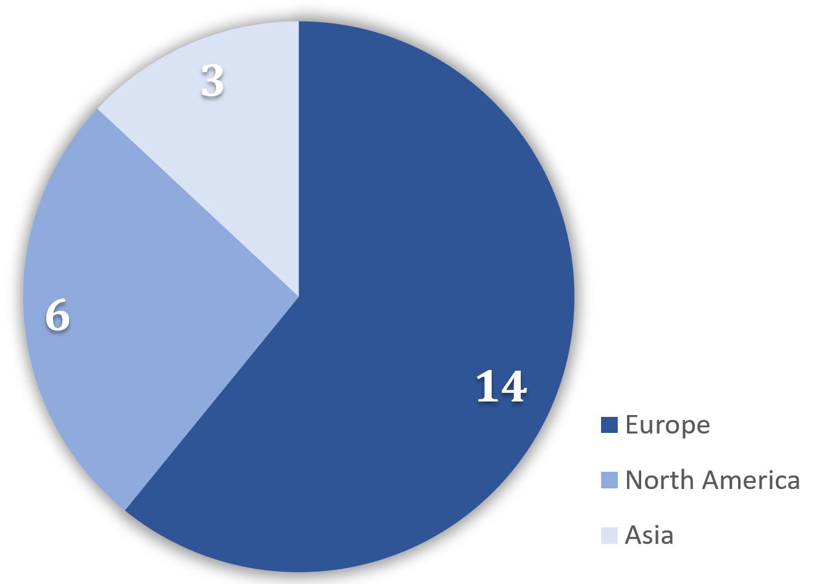
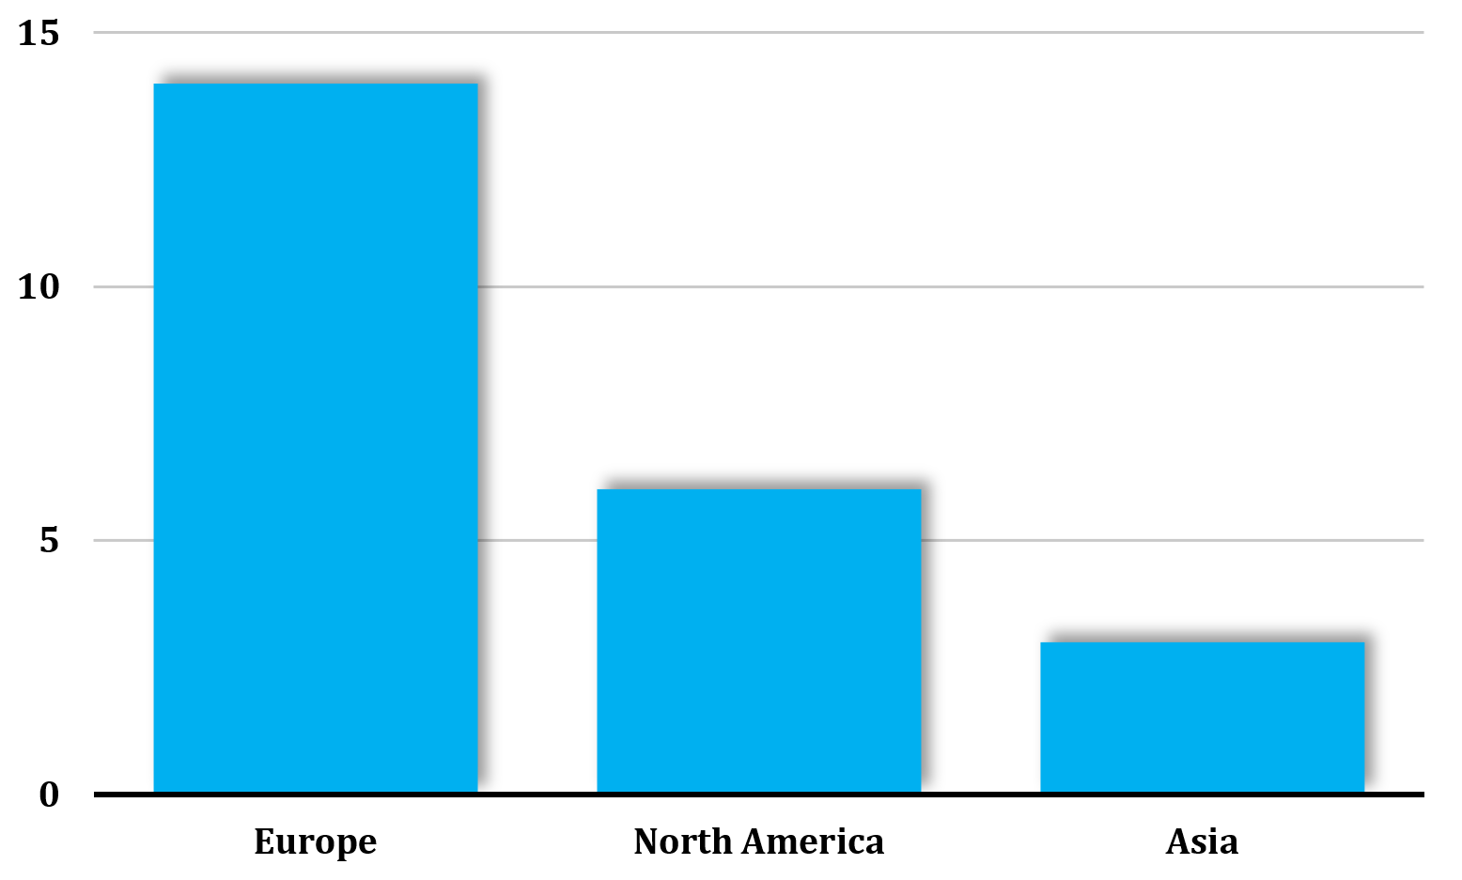
WINTER GAMES DATASET - EXAMPLE
Continent | Count
Europe | 14
North America | 6
Asia | 3
Then we can make the bar graph and the pie chart.
ENGR. VIOLDAN E. BAYOCOT
[Krista K.] BECOME A PROBABILITY & STATISTICS MASTER
QUANTITATIVE METHODS

Slide 21
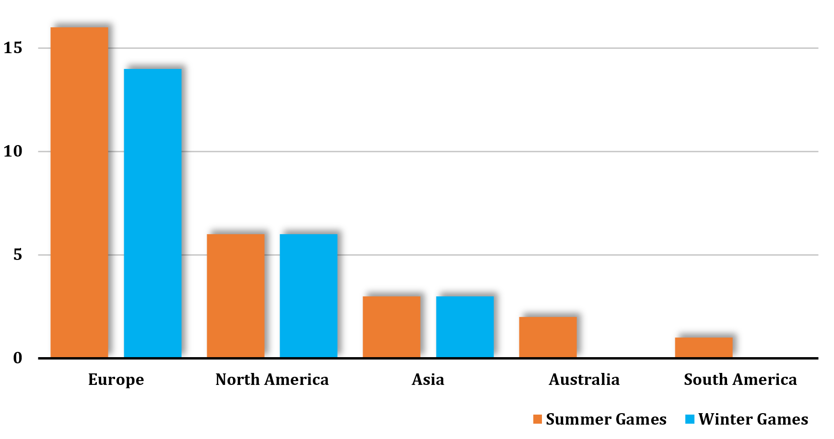
BAR GRAPH SIDE BY SIDE
Bar graphs are also great for showing multiple variables for the same individuals, side by side.
Now that we’ve created bar graphs for host continents for both the summer and winter Olympic games
This kind of side-by-side bar graph allows us to quickly see what we already knew from the previous bar graphs, like the fact that Europe has hosted more summer games and more winter games than any other continent.
But we get more information from this, too, like the fact that Europe has hosted more summer games than it has winter games, or that North America has hosted an equal number of summer and winter games.
ENGR. VIOLDAN E. BAYOCOT
[Krista K.] BECOME A PROBABILITY & STATISTICS MASTER
QUANTITATIVE METHODS

Slide 22
| University of San Jose - Recoletos | School of Computer Studies
| Quantitative Methods | Engr. Violdan E. Bayocot
SUB-MODULE 01.03 – LINE GRAPHS AND OGIVES
MODULE 01
VISUALIZING DATA
ENGR. VIOLDAN E. BAYOCOT
[Krista K.] BECOME A PROBABILITY & STATISTICS MASTER
QUANTITATIVE METHODS

Slide 23
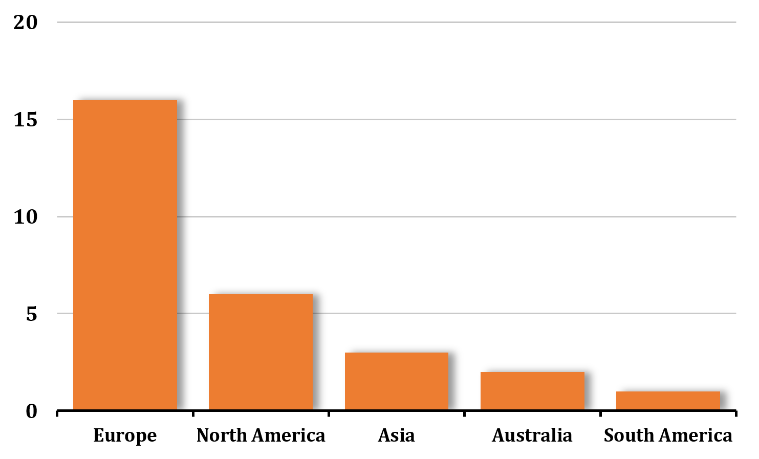
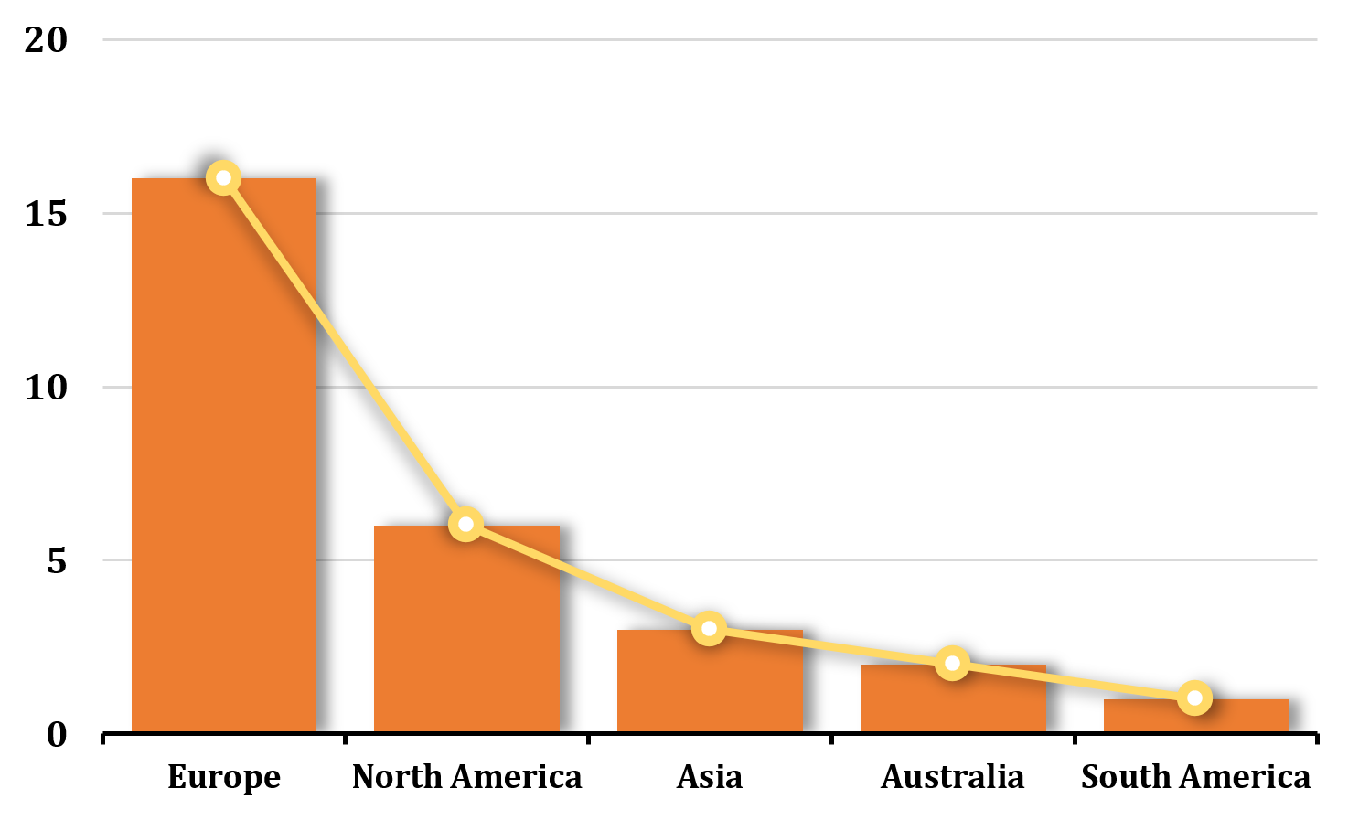
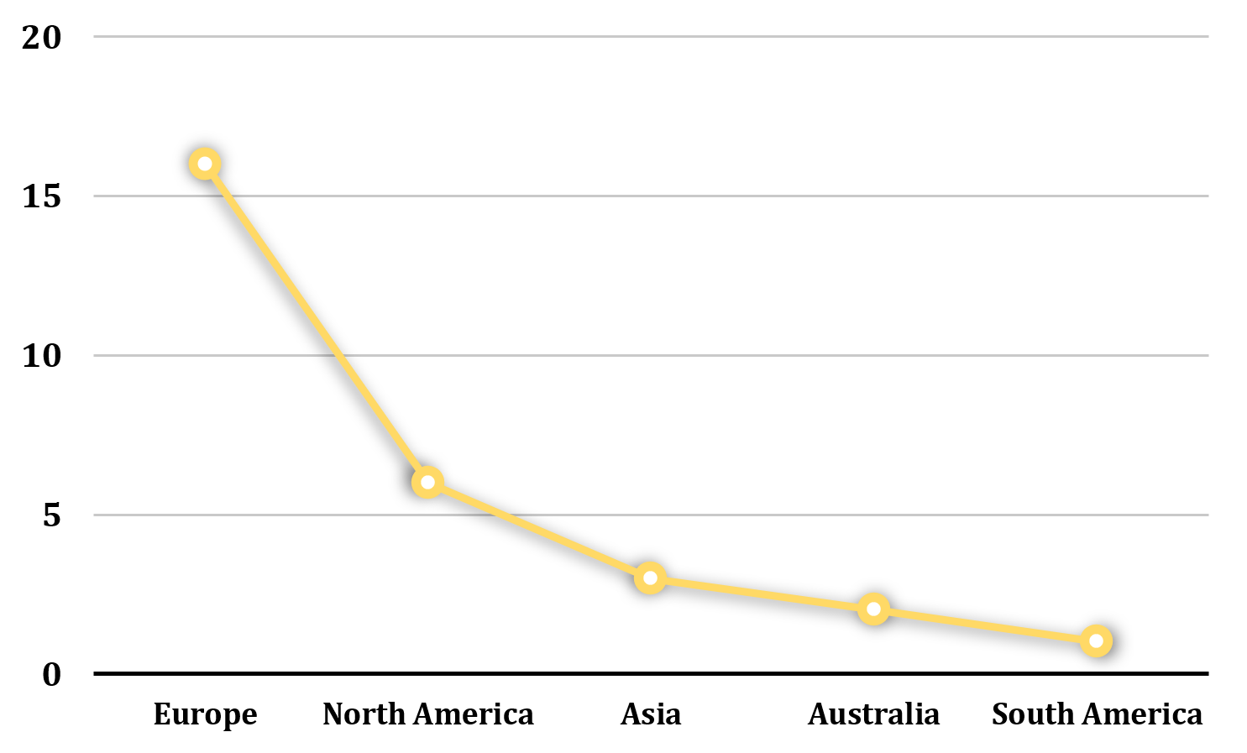
LINE GRAPHS
Line graphs are really similar to bar graphs.
In fact, to turn a bar graph into a line graph, all we have to do is connect the middle of the top of each bar to the middle of the top of the bar beside it with a straight line, and we’ll form the line graph.
ENGR. VIOLDAN E. BAYOCOT
[Krista K.] BECOME A PROBABILITY & STATISTICS MASTER
QUANTITATIVE METHODS

Slide 24
LINE GRAPHS
Line graphs are really similar to bar graphs.
In fact, to turn a bar graph into a line graph, all we have to do is connect the middle of the top of each bar to the middle of the top of the bar beside it with a straight line, and we’ll form the line graph.
In actuality, a line graph is a bad choice for this data.
Line graphs are used to show changes over time or a connection between individuals, but this data is comparing things between different groups. That means the bar graph is a better choice than a line graph for this data in particular.
Let’s look at an example with data that’s much better suited for a line graph
ENGR. VIOLDAN E. BAYOCOT
[Krista K.] BECOME A PROBABILITY & STATISTICS MASTER
QUANTITATIVE METHODS

Slide 25
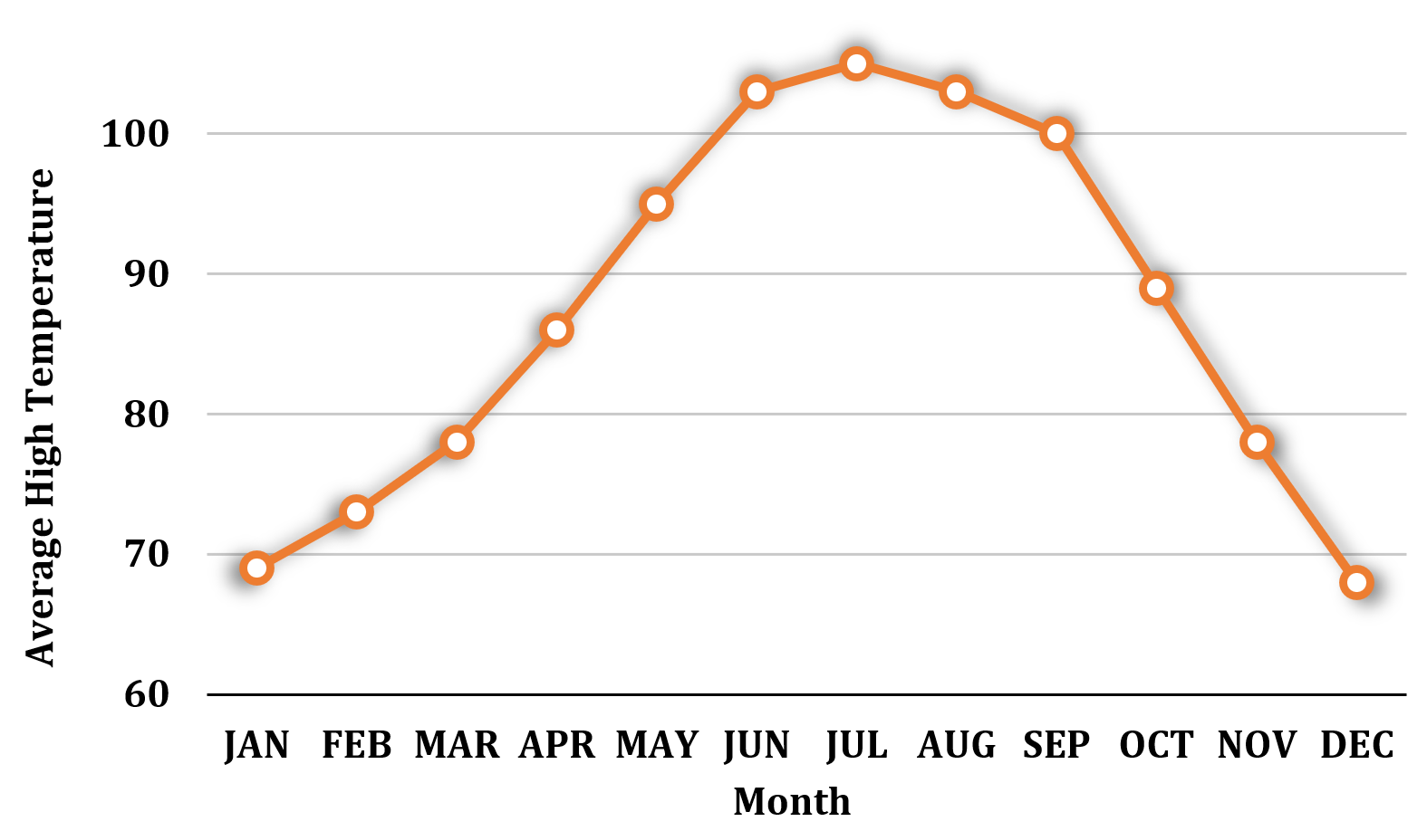
LINE GRAPHS
Let’s look at an example with data that’s much better suited for a line graph
Monthly average high temperature in Scottsdale, Arizona over the course of a year.
The historical average high temperature in degrees Fahrenheit is given for each month. If we plot these as a line graph, we get
Month | Average high
JAN | 69
FEB | 73
MAR | 78
APR | 86
MAY | 95
JUN | 103
JUL | 105
AUG | 103
SEP | 100
OCT | 89
NOV | 78
DEC | 68
ENGR. VIOLDAN E. BAYOCOT
[Krista K.] BECOME A PROBABILITY & STATISTICS MASTER
QUANTITATIVE METHODS

Slide 26
LINE GRAPHS
Notice that the slope of each line segment gives us an idea of how much change occurred between two data points.
A line graph is a fantastic way to display this kind of data, mostly because it shows clearly how a data point changes over time.
We inherently understand that average high temperature fluctuates over the course of a year
ENGR. VIOLDAN E. BAYOCOT
[Krista K.] BECOME A PROBABILITY & STATISTICS MASTER
QUANTITATIVE METHODS

Slide 27
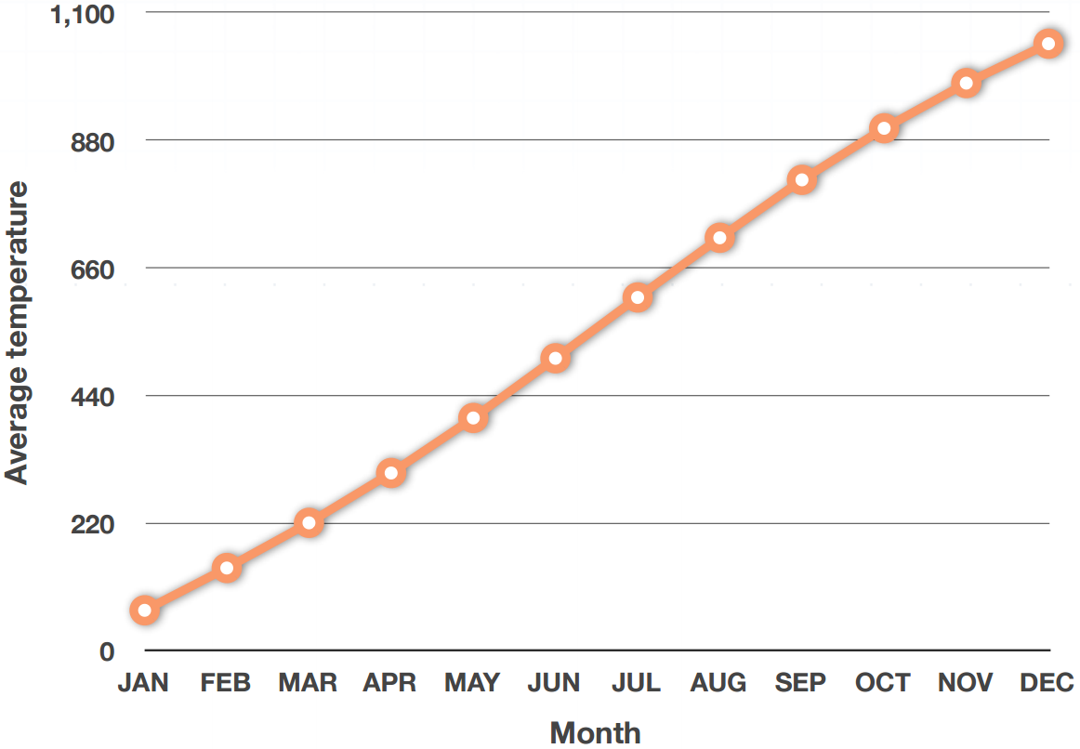
OGIVES
An ogive is a special kind of line graph.
This kind of graph looks just like a line graph, but think of an ogive as an accumulated line graph.
Taking the average monthly temperature in Scottsdale, Arizona, we would show the temperature in January as 69, the temperature in February as 69 + 73, the temperature in March as 69 + 73 + 78 etc.
It doesn’t make sense to show accumulated temperature over time!
It doesn’t make sense to have a temperature of almost 1,000 degrees in December.
Temperature is not a very good data point to represent with an ogive.
But an ogive would be perfect for showing something like accumulated savings over time
ENGR. VIOLDAN E. BAYOCOT
[Krista K.] BECOME A PROBABILITY & STATISTICS MASTER
QUANTITATIVE METHODS

Slide 28
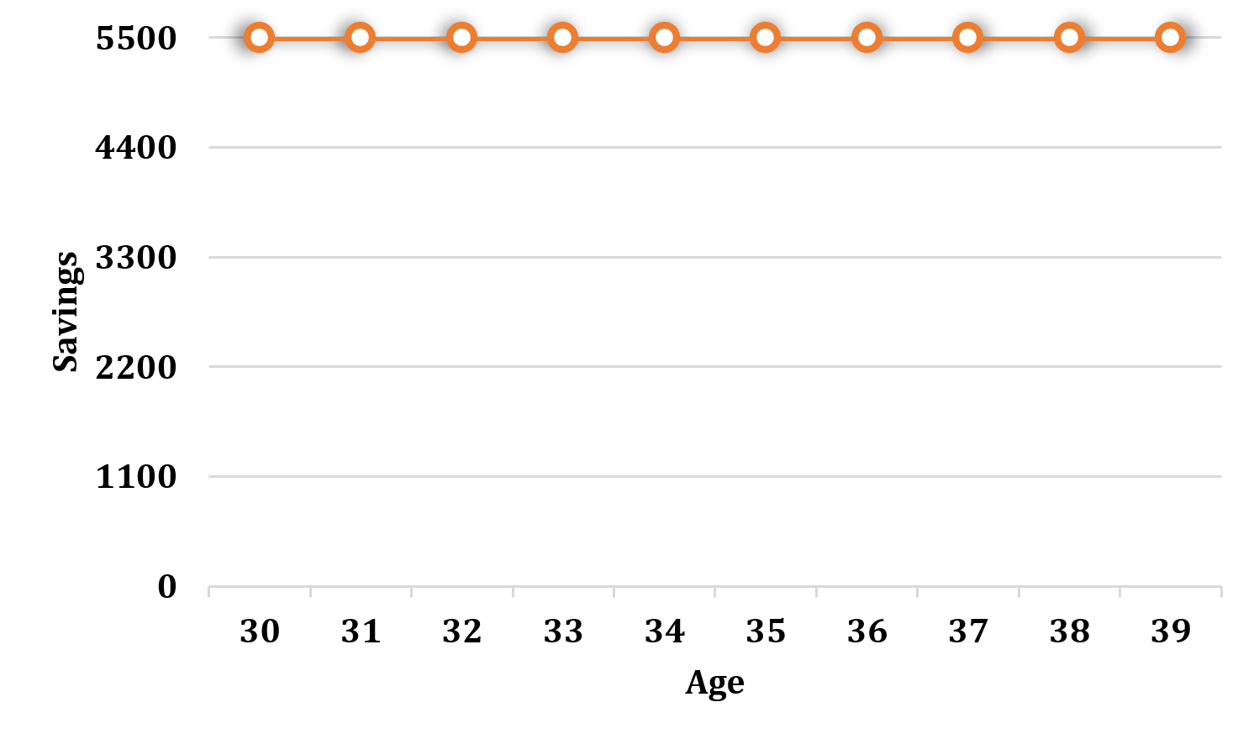
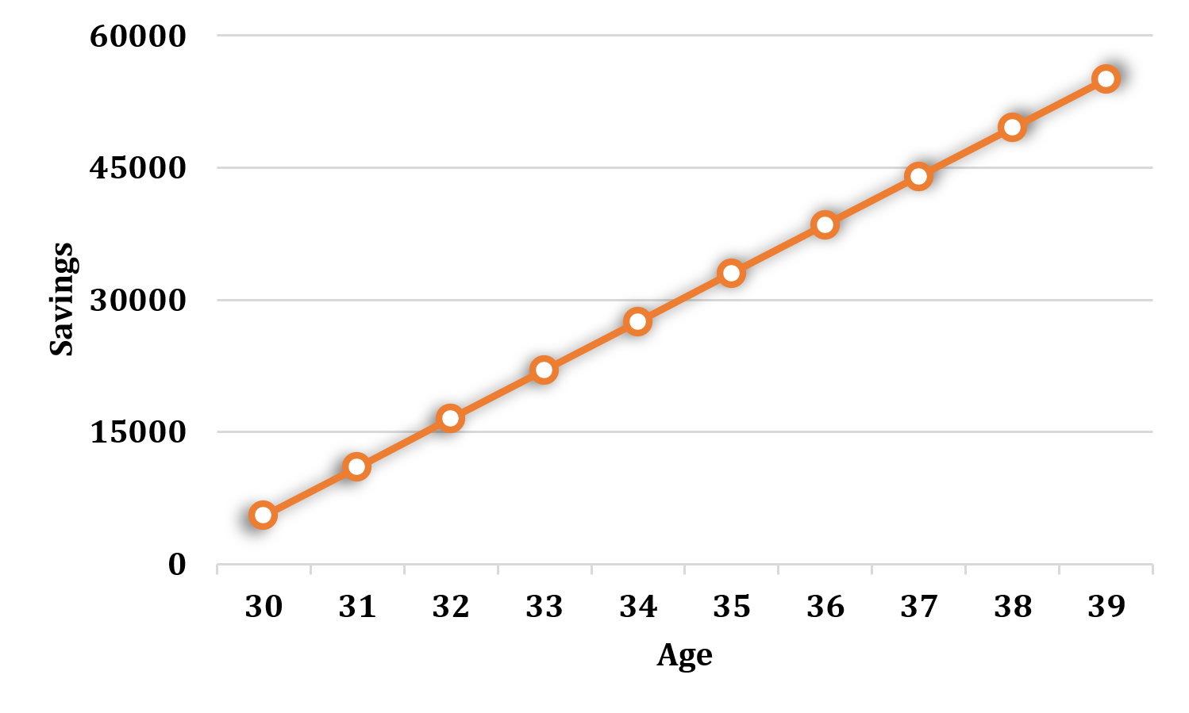
OGIVES
But an ogive would be perfect for showing something like accumulated savings over time
Let’s say we invest ₱5,500 each year into a savings account, from age 30 until age 39
While this is valuable information, we might be even more interested in the accumulated amount over time.
Graphing the accumulated total each year could be much more valuable, because it gives us visibility into how our savings will grow over time
Total
₱5,500
₱11,000
₱16,500
₱22,000
₱27,500
₱33,000
₱38,500
₱44,00
₱49,500
₱55,000
Graphing the invested amount each year in a line graph
Age | Investment
30 | ₱5,500
31 | ₱5,500
32 | ₱5,500
33 | ₱5,500
34 | ₱5,500
35 | ₱5,500
36 | ₱5,500
37 | ₱5,500
38 | ₱5,500
39 | ₱5,500
ENGR. VIOLDAN E. BAYOCOT
[Krista K.] BECOME A PROBABILITY & STATISTICS MASTER
QUANTITATIVE METHODS

Slide 29
OGIVES
From this ogive, we can quickly see that we’ll have something between ₱50,000 and ₱60,000 once we’ve made our investment at age 39. Or we can see that we’ll cross the ₱30,000 mark once we make our investment at age 35.
ENGR. VIOLDAN E. BAYOCOT
[Krista K.] BECOME A PROBABILITY & STATISTICS MASTER
QUANTITATIVE METHODS

Slide 30
UNIVERSITY OF SAN JOSE - RECOLETOS
THANK YOU!
“The greatest value of a picture is when it forces us to notice what we never expected to see.”
— John W. Tukey
ENGR. VIOLDAN E. BAYOCOT
SCHOOL OF COMPUTER STUDIES

